Slide 1
Analyzing student activity in the Computer Programming course
Tartu 2023

Slide 2
Team Introduction
Project Owner : Reimo Palm – course instructor
X
Classifying students, Intermediate Presentation
Xinyue Zhang
Yucui Wu
Lanxiang
Zhang
Jian Zhang
Y
Data Cleaning, Predicting final scores, Final Presentation
L
Result analysis, Webpage construction of dynamic effect display
J
Build a framework for Classifying students, Continuous optimization

Slide 3
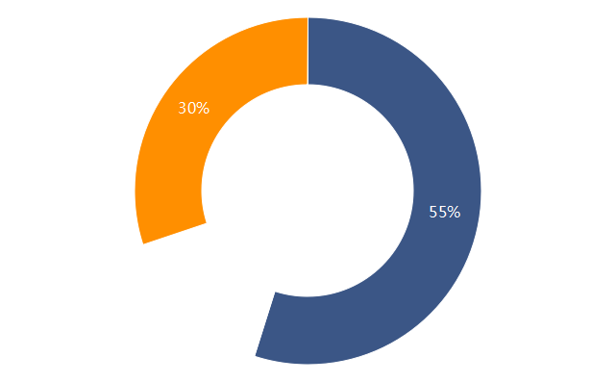
Project Motivation
Help students to modify their learning patterns to improve learning outcomes
Predict the final score based on
their early activity
Help teachers to change their teaching models to improve teaching effectiveness
Classify the students based on
their typical study patterns
Tap into more effective teaching models
and strategies

Slide 4
Methods - 1
Features
max score
max score + nr attempts
first score + last score + nr attempts
Models
Linear Regression
Decision Trees Random Forest
XGBoost
SVM
Evaluation
MSE
MAE
best
Experimenting with
different models
Feature Engineering
Data Preprocessing & Merging

Slide 5
Results - 1
MSE/MAE | max score | max score + nr attempts | first score + last score + nr attempts
Linear Regression | 252.1/11.8 | 250.7/11.6 | 258.5/11.9
Decision Trees | 333.7/12.6 | 423.3/14.2 | 395.0/14.3
Random Forest | 194.1/10.1 | 188.5/9.9 | 185.2/9.7
SVM | 571.0/16.4 | 368.2/16.4 | 568.8/16.3
XGBoost | 233.9/11.1 | 226.0/11.1 | 217.4/10.3

Slide 6
Methods - 2
Features
sum of attempts +
sum of max score + course score
Unsupervised model
kmeans
Evaluation
Silhouette Coefficient
elbow method
best K
donate lables
Unsupervised model
kmeans
K
exact type
predict lables
Supervised model
LogisticRegression K-Nearest SVM Decision Tree
K
accuracy

Slide 7
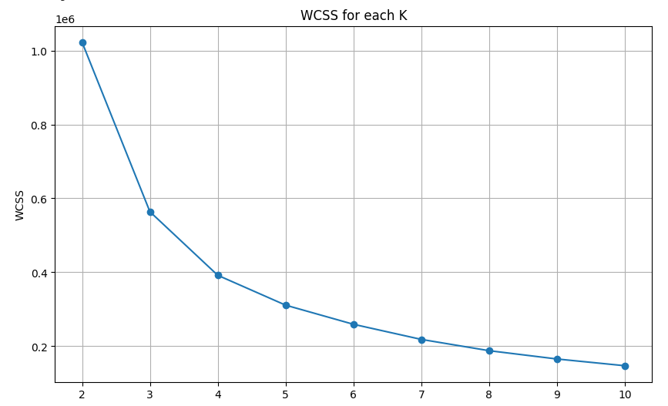
Results - 2
k | silhouette_avg
2 | 0.406
3 | 0.483
4 | 0.429
5 | 0.387
6 | 0.378
7 | 0.413
8 | 0.388
9 | 0.381
10 | 0.388
3

Slide 8
Results - 2
type | average sum of attempts | average sum of max score | average course score
Genius type | 65.4 | 10.9 | 86.9
Effort type | 135.0 | 12.2 | 86.8
Unmotivated type | 26.6 | 4.3 | 25.7

Slide 9
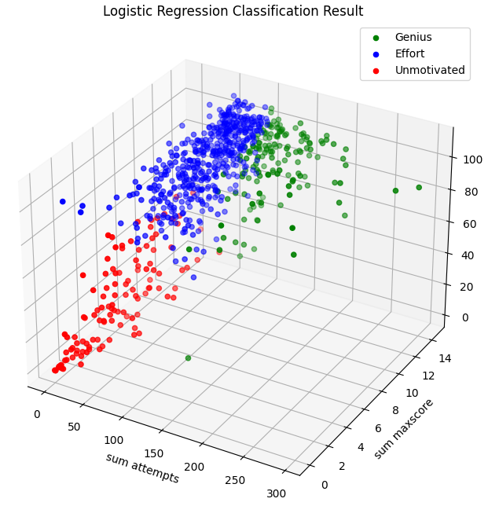
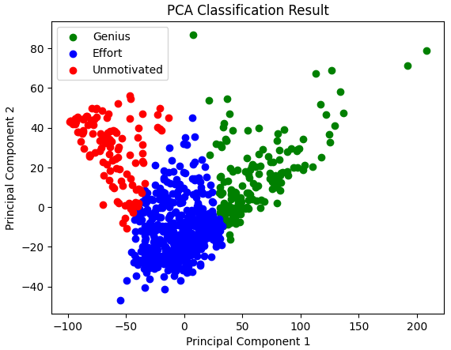
Results - 2

Slide 10
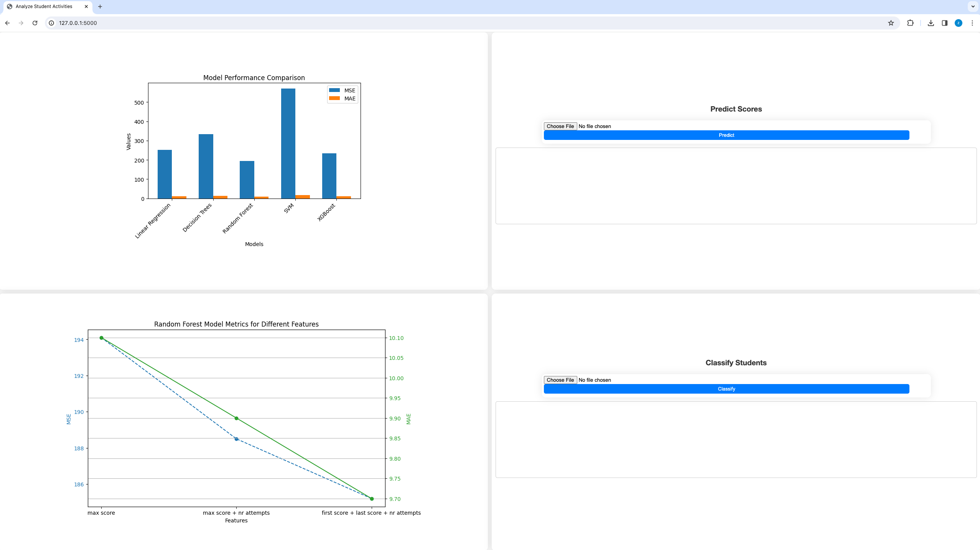
Results - Webpage

Slide 11
Lessons
Data
Is there enough data?
Is the data balanced?
Is the data clean?
What kind of features should we choose?
quantity? quality?
Features
Models
How to choose a model?
How to tune a model to get
better results?

Slide 12
Thank you !

